Slide 1
Master of Medicine at USI 11.5.2023

Slide 2
Master of Medicine’s – Primary aims
Train outstanding physicians
Train medical students for the federal medical licensing examination adequately and rigorously
Offer an innovative, attractive and motivating model which includes:
A lot of clinical practice, discussion of clinical cases and practical exercises
Working groups, constant and regular contact with professors
Curriculum based on «PROFILES»

Slide 3
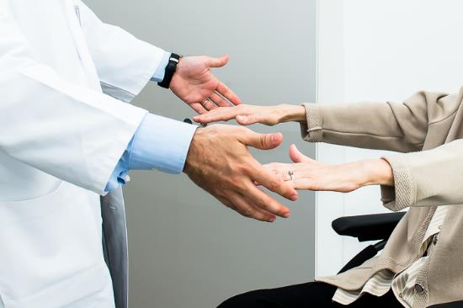
Educational principles of the model
Interact with and see many patients
Theoretical and practical lessons focused on priorities
Peer-assisted learning with senior physicians
Building a portfolio of in depth analysis of actual clinical cases
Interactive small groups
Learning by doing
EOC
EOC

Slide 4
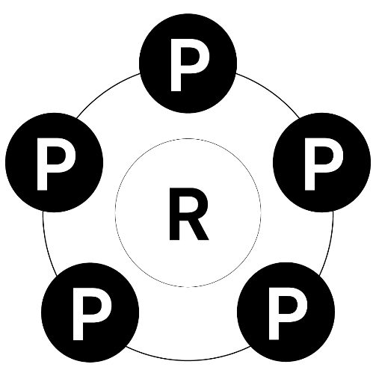
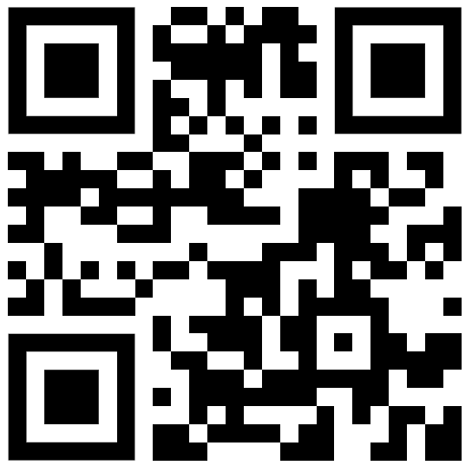
Our unique selling points
Proximity: Proximity to professors, clinical days student tutor ratio 2:1
Practice: Practice oriented training in small groups (bed-side teaching, simulated patients and high-tech simulations)
Profiles: Curriculum fully adapted and inspired to
Promotion: Possibility to start a Dr. med. or MD-PhD
Personal:
Personalized curriculum with various optional courses
Research: Research integrated in clinical modules and in optional courses
Profiles
Notes:
https://www.profilesmed.ch/

Slide 5
Curriculum: General structure
Each of the first 4 semesters consist of modules, transversal topics and 2 special weeks
Modules:
1st sem.: Circulation, homeostasis, immune disorders
2nd sem.: Women and Children, circulating cells and signaling
3rd sem.: Emergency and surgical approach, transversal practice
4th sem.: Nervous system, personality and cognition
Transversal topics throughout al 4 semesters:
Family medicine, Pathology, Infectious disease, Oncology, Imaging, Pharmacology / toxicology, Public health, Palliative care, Geriatrics and Doctor-patient communication
Special weeks:
1st sem.: 2 weeks of general introduction
2nd sem.: 2 weeks of bench to bedside
3rd sem.: 2 weeks of pediatric practice
4th sem.: 2 weeks of training at family doctor practice

Slide 6
“2 special weeks” program
1st semester – General introduction
Team building with professors
Introduction to transversal topics
Ticino health care system
Invasive maneuvers, minor surgery: theory and practice
Interprofessionality
2nd semester – Bench to bedside
Basic teaching of research activity
Medical research in Ticino: institutes, research fields and possibilities
Introduction and discussion on the Master Thesis
3rd semester - Pediatric practice (rotation of 3 groups)
Students perform, in groups of 2, a full time 2-weeks internship in pediatric practices
12-36 collaborating pediatricians will be specially trained to provide dynamic, high-quality teaching
4th semester - Family doctor practice (rotation of 3 groups)
Students perform, in groups of 2, a full time 2-weeks internship at a family doctor practice (General practitioner)
12-36 collaborating family doctors will be specially trained to provide dynamic, high-quality teaching

Slide 7
Curriculum: General structure
Clinical semester 1
Circulation, homeostasis and immune disorders
Clinical semester 2
Women and Children, circulating cells and signaling
Clinical semester 2
Continu-ing
General
Introduction
Holidays
Bench to bedside
Exams
Easter Holidays
Exams
Clinical semester 3
Emergency and surgical approach
Clinical semester 4
Nervous system, personality and cognition
Clinical semester 4
Nervous system, personality and cognition
Holidays
Holidays
Family doctor
Pediatric practice
Exams
Exams
Transversal practice
Easter Holidays
Elective term (6 months)
Complementary topics
Repetition and training for federal exam
Holidays
Holidays
Exams
Master thesis
Easter Holidays

Slide 8
Exams
Starting from the first semester, simulations of the federal exams will be performed regularly.
The exams focus on the main topics of the previous semester
Exams will include
Multiple choice (MC)
Simulated practical examination with actors (OSCE)
MC exams: after each clinical semester (1. – 4 semester) and at the end of the 6. semester
OSCE exams: after each clinical year (1. and 2. year) and at the end of the 6. semester

Slide 9
First semester: Circulation, homeostasis and immune disorders
1
2
3
4
5
6
7
8
9
10
11
12
13
14
Circulation
Homeostasis (respiration, hemodynamics, fluids and electrolytes)
Immune disorders
(immunology, rheumatology,
dermatology)
Group A
N=24
General
introduction
Homeostasis (respiration, hemodynamics, fluids and electrolytes)
Immune disorders
(immunology, rheumatology,
dermatology)
Circulation
Group B
N=24
Immune disorders
(immunology, rheumatology,
dermatology)
Circulation
Homeostasis
(respiration, hemodynamics, fluids and electrolytes)
Group C
N=24

Slide 10
Second semester: Women and children, circulating cells and signaling
1
2
3
4
5
6
7
8
9
10
11
12
13
14
Children and adolescents
Women
(Gynecology and obstetrics)
Circulating cells and signaling (Hematology and endocrinology)
Circulating cells and signaling (Hematology and endocrinology)
Children and adolescents
Bench to bedside
Women
(Gynecology and obstetrics)
Women
(Gynecology and obstetrics)
Circulating cells and signaling (Hematology and endocrinology)
Children and adolescents

Slide 11
Third semester: Emergency and surgical approach, transversal practice
1
2
3
4
5
6
7
8
9
10
11
12
13
14
Abdominal organs
(liver, kidney, intestine)
Pediatric practice
Critical Care (Anesthesiology
intensive care, emergency)
Transversal practice
Skeleton
(Orthopedics, traumatology)
Transversal practice
Skeleton
(Orthopedics, traumatology)
Abdominal organs
(liver, kidney, intestine)
Pediatric practice
Critical Care (Anesthesiology
intensive care, emergency)
Pediatric practice
Critical Care (Anesthesiology
intensive care, emergency)
Transversal practice
Skeleton
(Orthopedics, traumatology)
Abdominal organs
(liver, kidney, intestine)

Slide 12
Forth semester: Nervous system, personality and cognition
1
2
3
4
5
6
7
8
9
10
11
12
13
14
Family doctor
Nervous system (Neurology, neurosurgery)
Personality and cognition (Psychiatry, medical psychology)
Head and neck organs (ORL, ophthalmology)
Head and neck organs (ORL, ophthalmology)
Family doctor
Nervous system (Neurology, neurosurgery)
Personality and cognition (Psychiatry,
medical psychology)
Personality and cognition (Psychiatry,
medical psychology)
Head and neck organs (ORL, ophthalmology)
Family doctor
Nervous system (Neurology, neurosurgery)

Slide 13
Modules and topics
Vertical responsibility (modules)
Circulating cells and signaling – Endocr., hematol.
Nervous system – Neurol., neurosurgery
Abdominal organs – Digest.sys., urolo.
Immune disorders – Immuno, rheuma, dermato
Critical care – Anesthesiol., intensive care, emergency
Personality and cognition – Psychiatry, psychology
Children and adolescent – Pediatrics
Head and neck organs – ORL, ophthal.
Homeostasis – Respira., nephrol.
Women – Gyneco., obstetrics
Skeleton – Orthoped., traumatol.
Circulation – Cardiol., angiol.
Transversal topics
Family medicine / patient care / quality & safety
Pathology
Infective medicine / travel medicine
Oncology
Imaging
Pharmacology / toxicology
Public Health / ethics / insurance medicine
Geriatrics
Palliative care
Doctor-Patient Communication
Notes:
We defined vertical and trasversal responsabilities
The 12 vertical responsabilitiesare referred to the modules and each module will have a responsabile professor
Whereas the transversal responsabilities concern all to the topic taught throughout the different modules

Slide 14
Structure of the week
Theoretical lessons
2h theory on transversal topics, all
2h theory multidisciplinary on module themes, all
4h theory on the module themes, 3 groups
Practice oriented teaching activity (groups of 8 students)
4h of clinical case discussions or practical exercises on the module themes
→ cases covering major diseases and prepared according to PROFILES: Situation as starting point
1 half-day individual preparation of own case portfolio
Clinical activity
1.5 days of clinical activity at the hospital, 2 students with a Senior physician
Assessment and feedback
1h assessment and feedback at the end of each week, 3 groups
Optional courses
2 optional courses of choice per semester, each course consists in 12h of lectures and practice
2 half-days individual study

Slide 15
Typical week of 1st year MMED
 | Monday | Tuesday | Wednesday | Thursday | Friday
08:30 – 09:15 09:30 – 10:15
10:30 – 11:15 11:30 – 12:15
12:15 – 13:30
13:30 – 14:15 14:30 – 15:15
15:30 – 16:15 16:30 – 17:15
Theoretical lessons
Transversal themes
(all)
Clinical activity at hospital
(2 students with a Senior)
Clinical activity at hospital
(2 students with a Senior)
Theoretical lessons
Module theme
(3 groups)
Theoretical lessons
Module theme
(3 groups)
Theoretical lessons
Multidisciplinary
(all)
Clinical activity at hospital
(2 students with a Senior)
Clinical activity at hospital
(2 students with a Senior)
Discussion of clinical cases or practical exercises
Module theme
(in groups of 8)
Discussion of clinical cases or practical exercises
Module theme
(in groups of 8)
Optional subjects
Clinical activity at hospital
(2 students with a Senior)
Case preparation
(individually at hospital)
Individual study
Assessment and feedback
Individual study
Optional subjects
Clinical activity at hospital
(2 students with a Senior)

Slide 16
Typical week of 2nd year MMED
 | Monday | Tuesday | Wednesday | Thursday | Friday
08:30 – 09:15 09:30 – 10:15
10:30 – 11:15 11:30 – 12:15
12:15 – 13:30
13:30 – 14:15 14:30 – 15:15
15:30 – 16:15 16:30 – 17:15
Theoretical lessons
Transversal themes
(all)
Theoretical lessons
Module theme
(3 groups)
Theoretical lessons
Module theme
(3 groups)
Clinical activity at hospital
(2 students with a Senior)
Clinical activity at hospital
(2 students with a Senior)
Theoretical lessons
Multidisciplinary
(all)
Discussion of clinical cases or practical exercises
Module theme
(in groups of 8)
Discussion of clinical cases or practical exercises
Module theme
(in groups of 8)
Clinical activity at hospital
(2 students with a Senior)
Clinical activity at hospital
(2 students with a Senior)
Optional subjects
Individual study
Assessment and feedback
Clinical activity at hospital
(2 students with a Senior)
Case preparation
(individually at hospital)
Individual study
Optional subjects
Clinical activity at hospital
(2 students with a Senior)

Slide 17
5. Semester – Elective term (E.T.)
6 months mandatory –
Between August and February

Slide 18
6. Semester

Slide 19
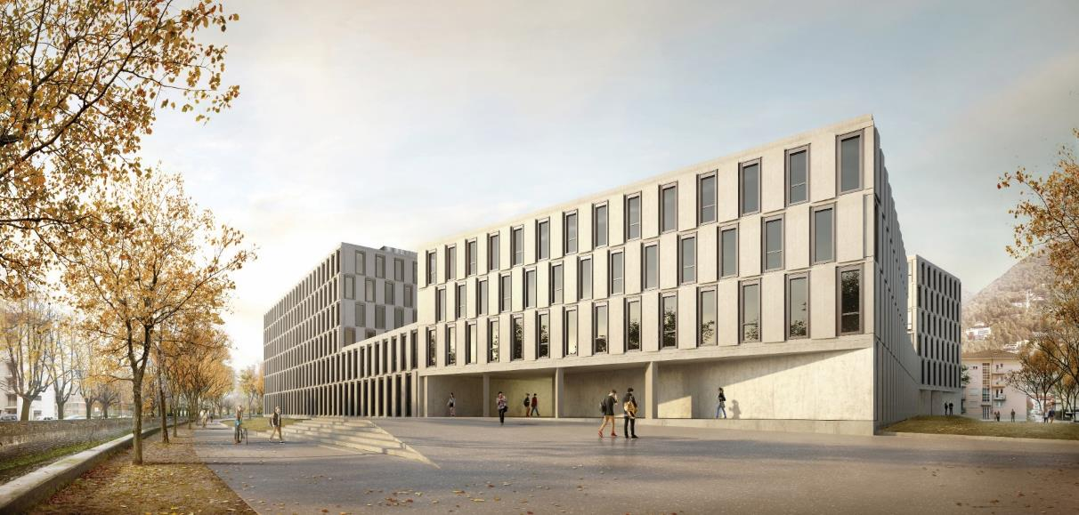
Thank you!

